Slide 1
Sesson 11
Working with Netbeans, Github

Slide 2
Clone a project from Github
There is a repo from Git
https://github.com/FGWStaff/SimpleWebsite
Now we are going to clone this repo to local and use it in Netbeans to develop the project
Assum that you already have
A Github account
Installed a PHP Web Server
A Heroku account

Slide 3
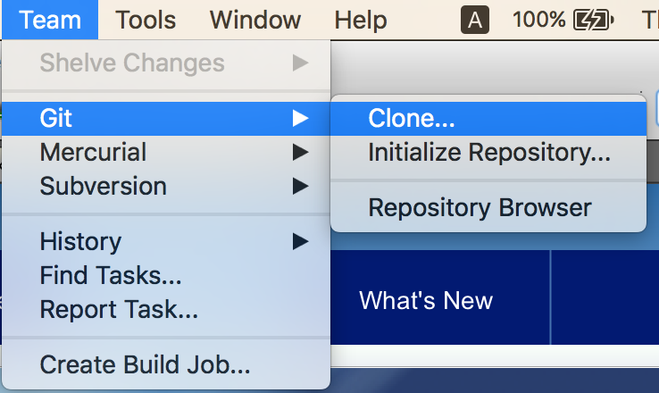
Step 1: Select Github feature from Netbeans

Slide 4
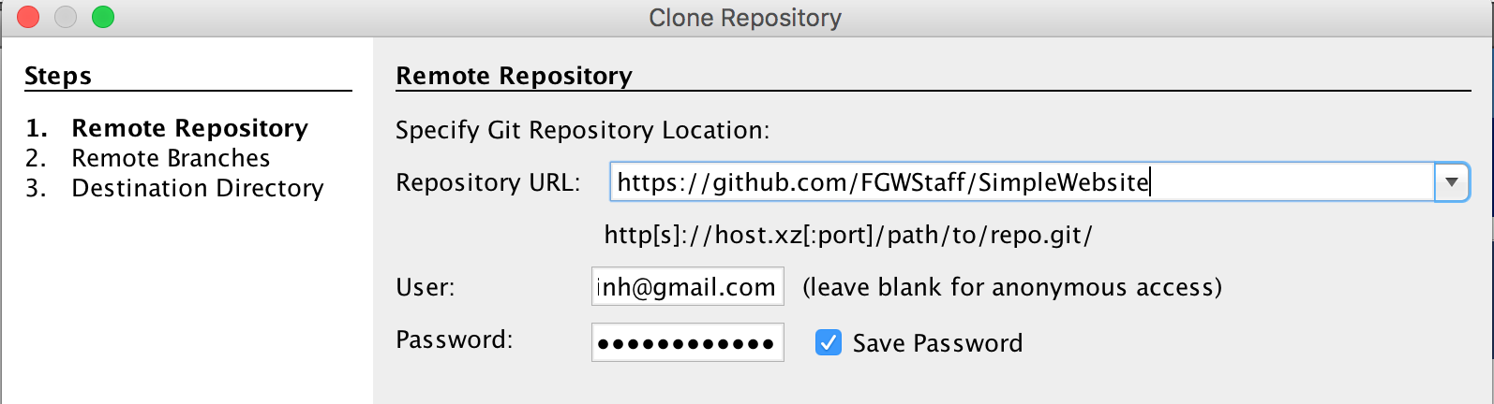
Step 2: specify GitHub account information
Enter your Github account information

Slide 5
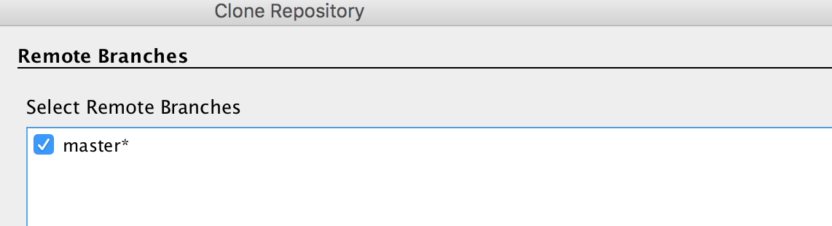
Step 3: Select the Branch

Slide 6
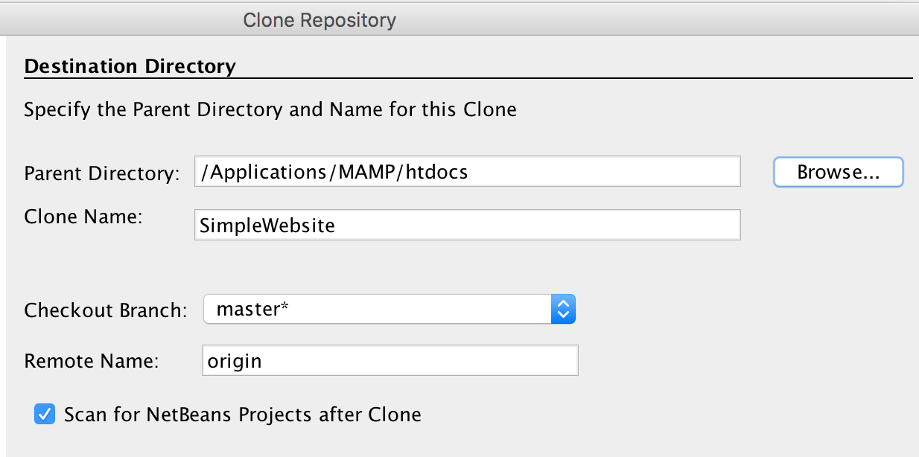
Step 4: Specify the destination directory
This is a PHP web application so point to the folder htdocs folder

Slide 7
Step 5
Netbeans will now ask you to create an application
You select yes
Then create a new PHP web application
When it asks the destination folder: point to the folder we created in step 4(in htdocs folder). You can see example as the screenshot below

Slide 8
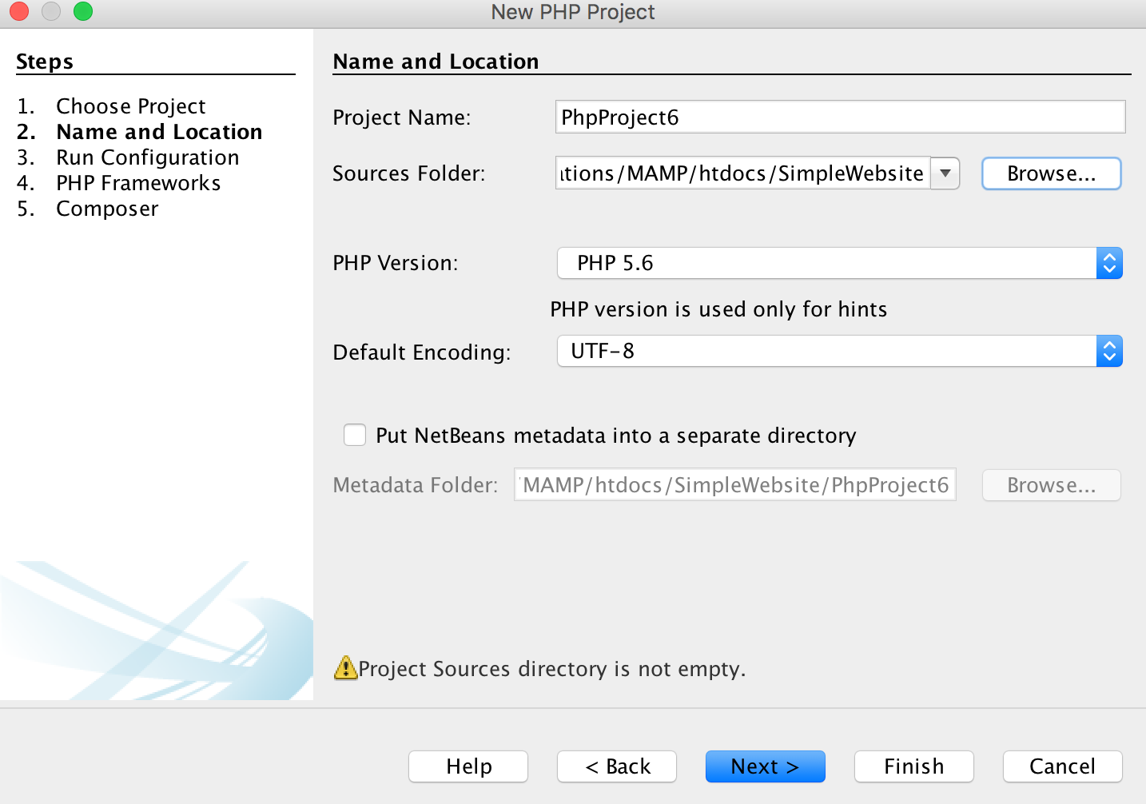
Change it to SimplePHPwebsite
The folder should be SimpleWebsite

Slide 9
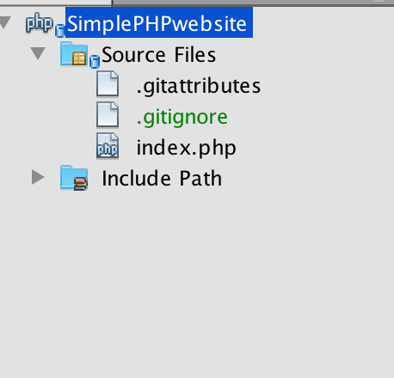
Step 6: a new Netbeans project created

Slide 10
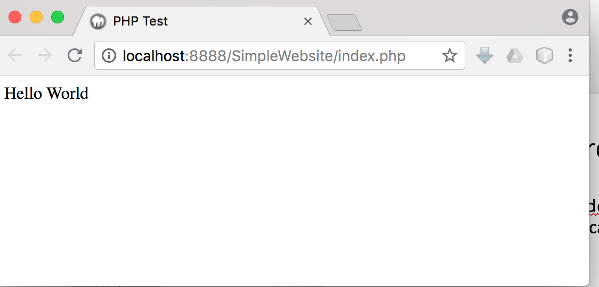
Step 7: Run the project
Now you select the file index.php and hit run( or Shift +F6) you can see the website display locally

Slide 11
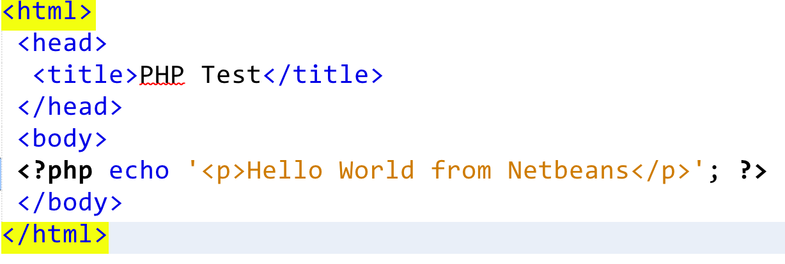
Make changes to local
Now you can make changes to the file index.php like this:

Slide 12
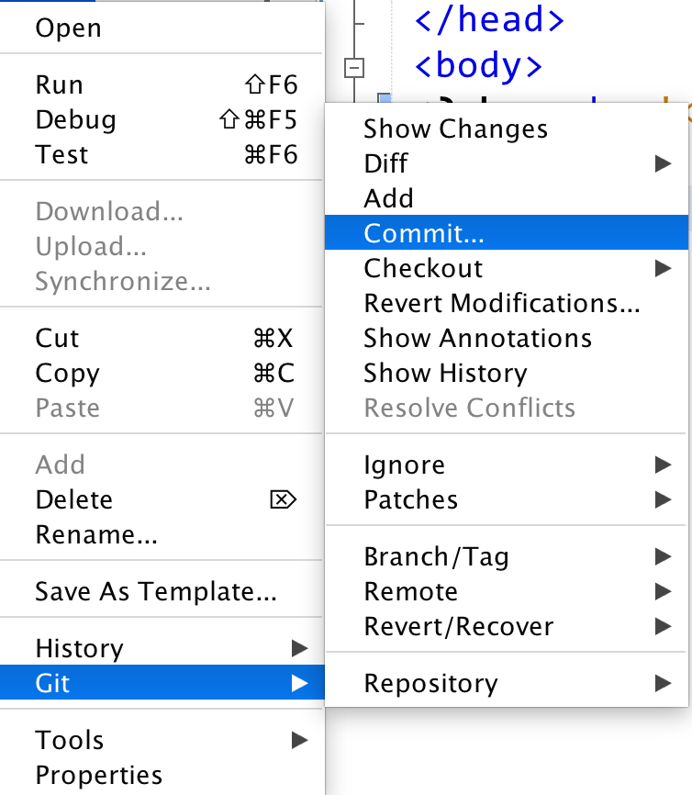
Commit changes
Right click the project and select Git->Commit

Slide 13
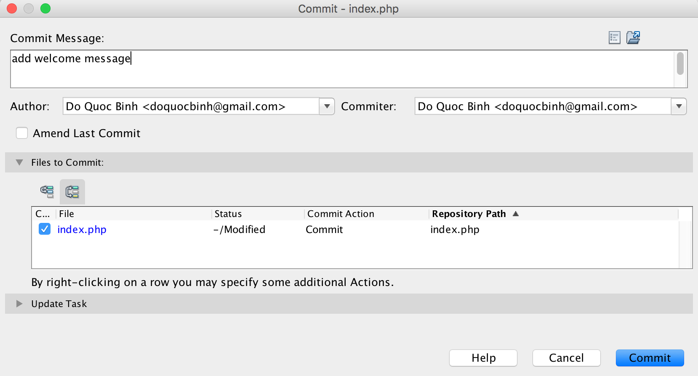
Enter commit message
Enter the message which describes what you changed
Your Github account information
List of files changed

Slide 14
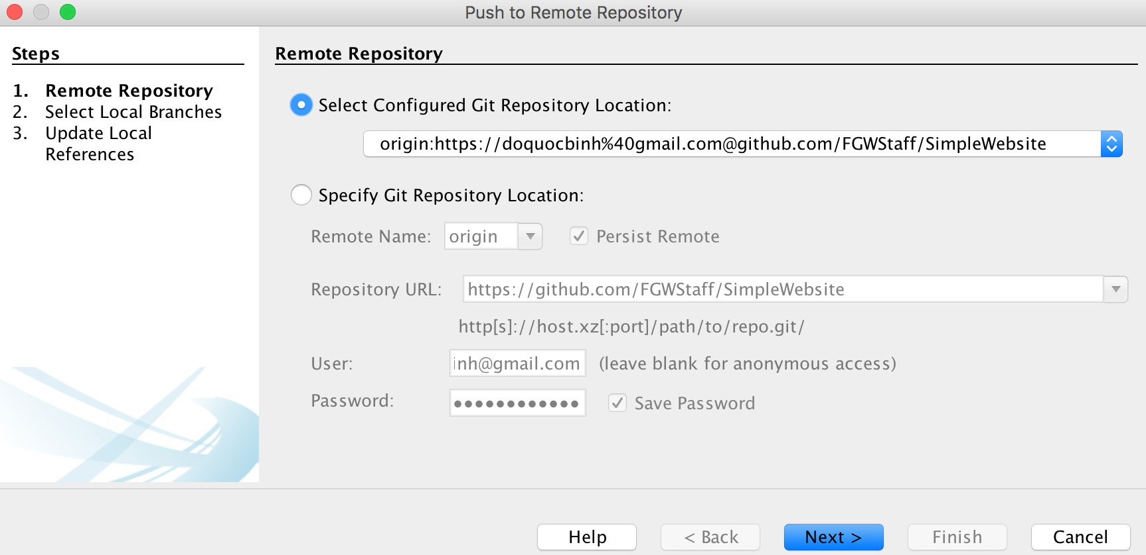
Push changes to Repo
Right click project and select Git-> Remote->Push

Slide 15
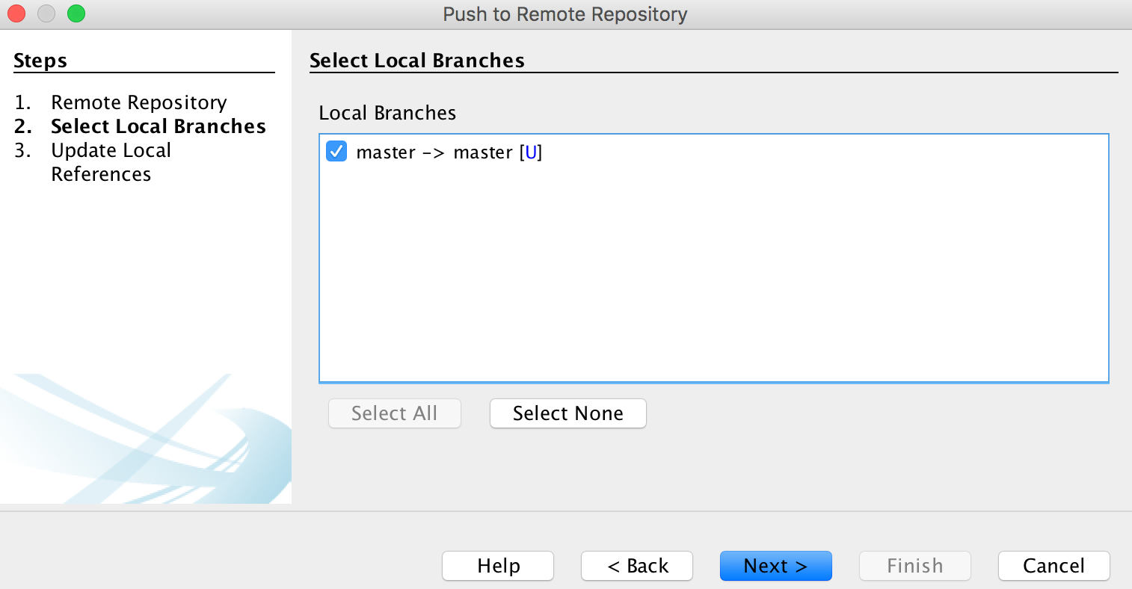
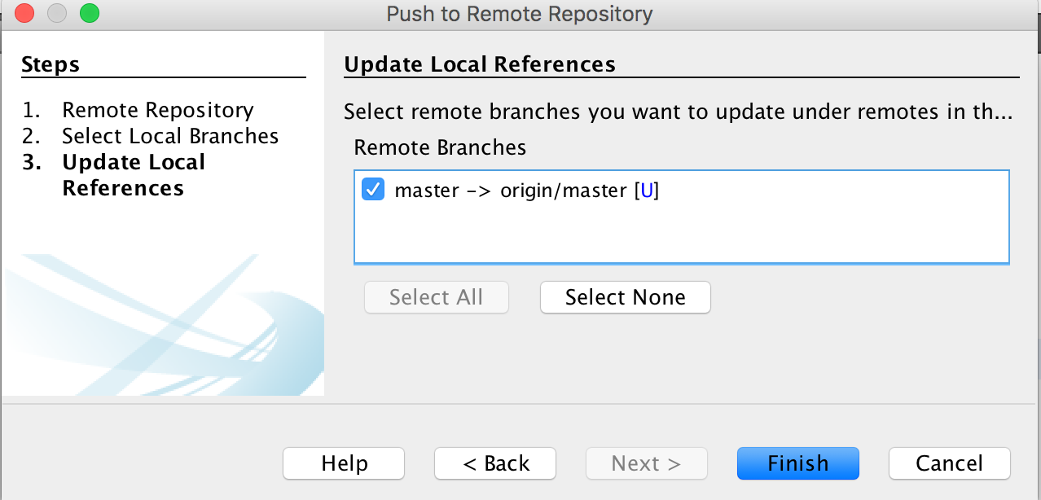

Slide 16
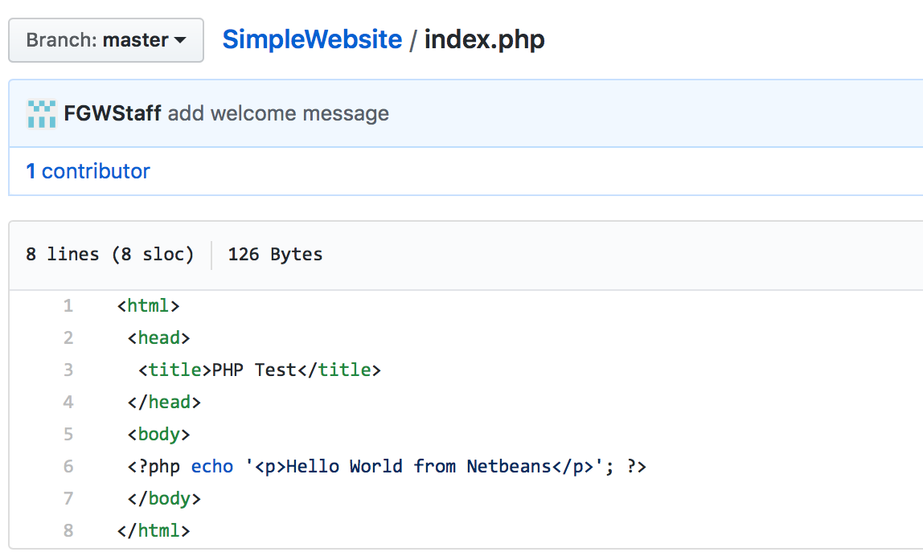
View submit changes from Repo
The message you entered will display here

Slide 17
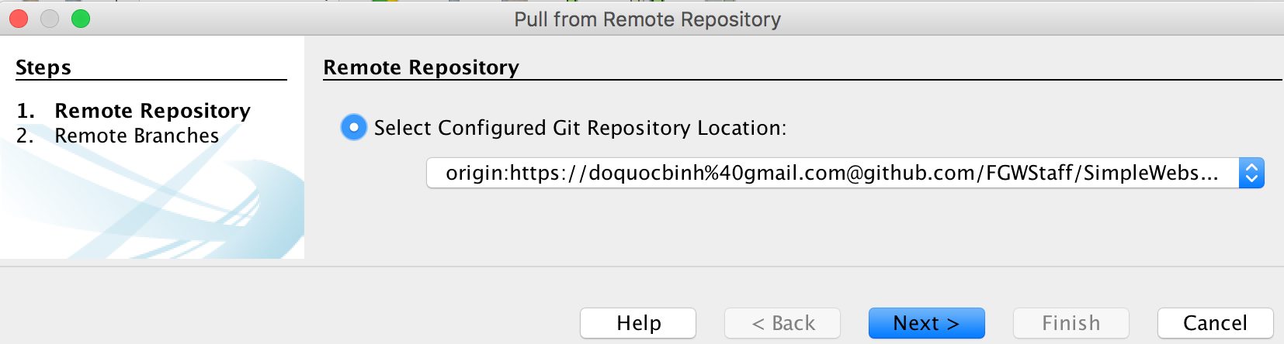
Pull changes from remote Repo to local

Slide 18
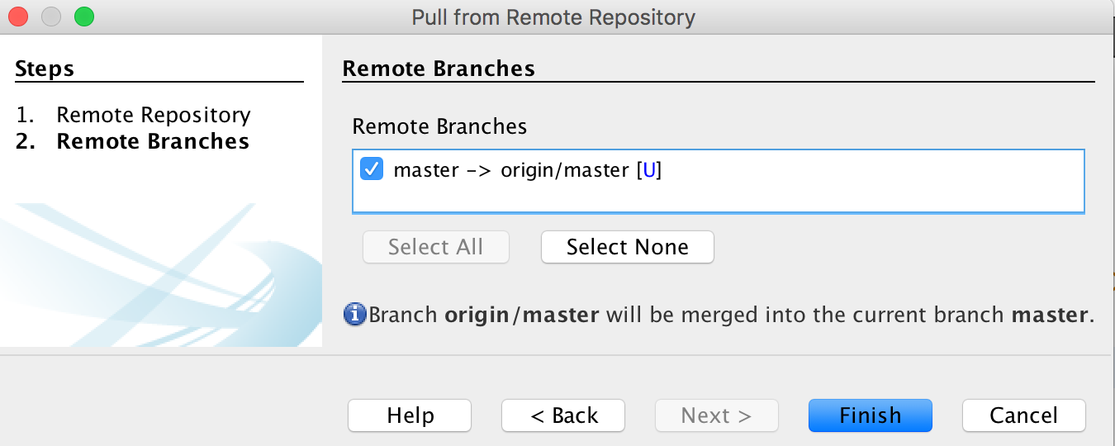
Pull changes from remote Repo to local(2)

Slide 19
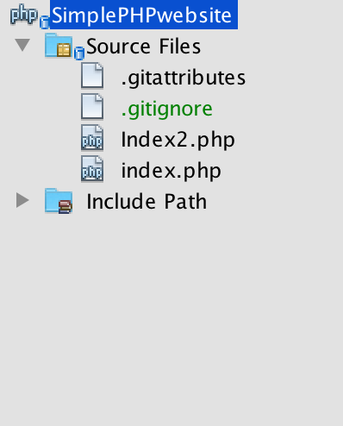
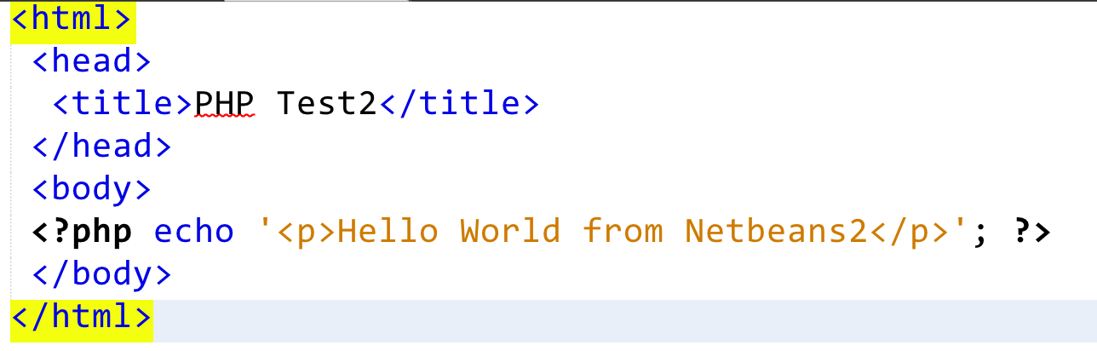
A new file has been added to the local project

Slide 20
Exercise
Add a new file to NetBeans called helloWorld.php
Submit the file to the remote Repo so everyone can see
Add a new php project with NetBeans and share it on Github with your closed classmate
Ask you classmate to change the file
Get the changes from you friend to the local
Host your project on Heroku to run

